Slide 1
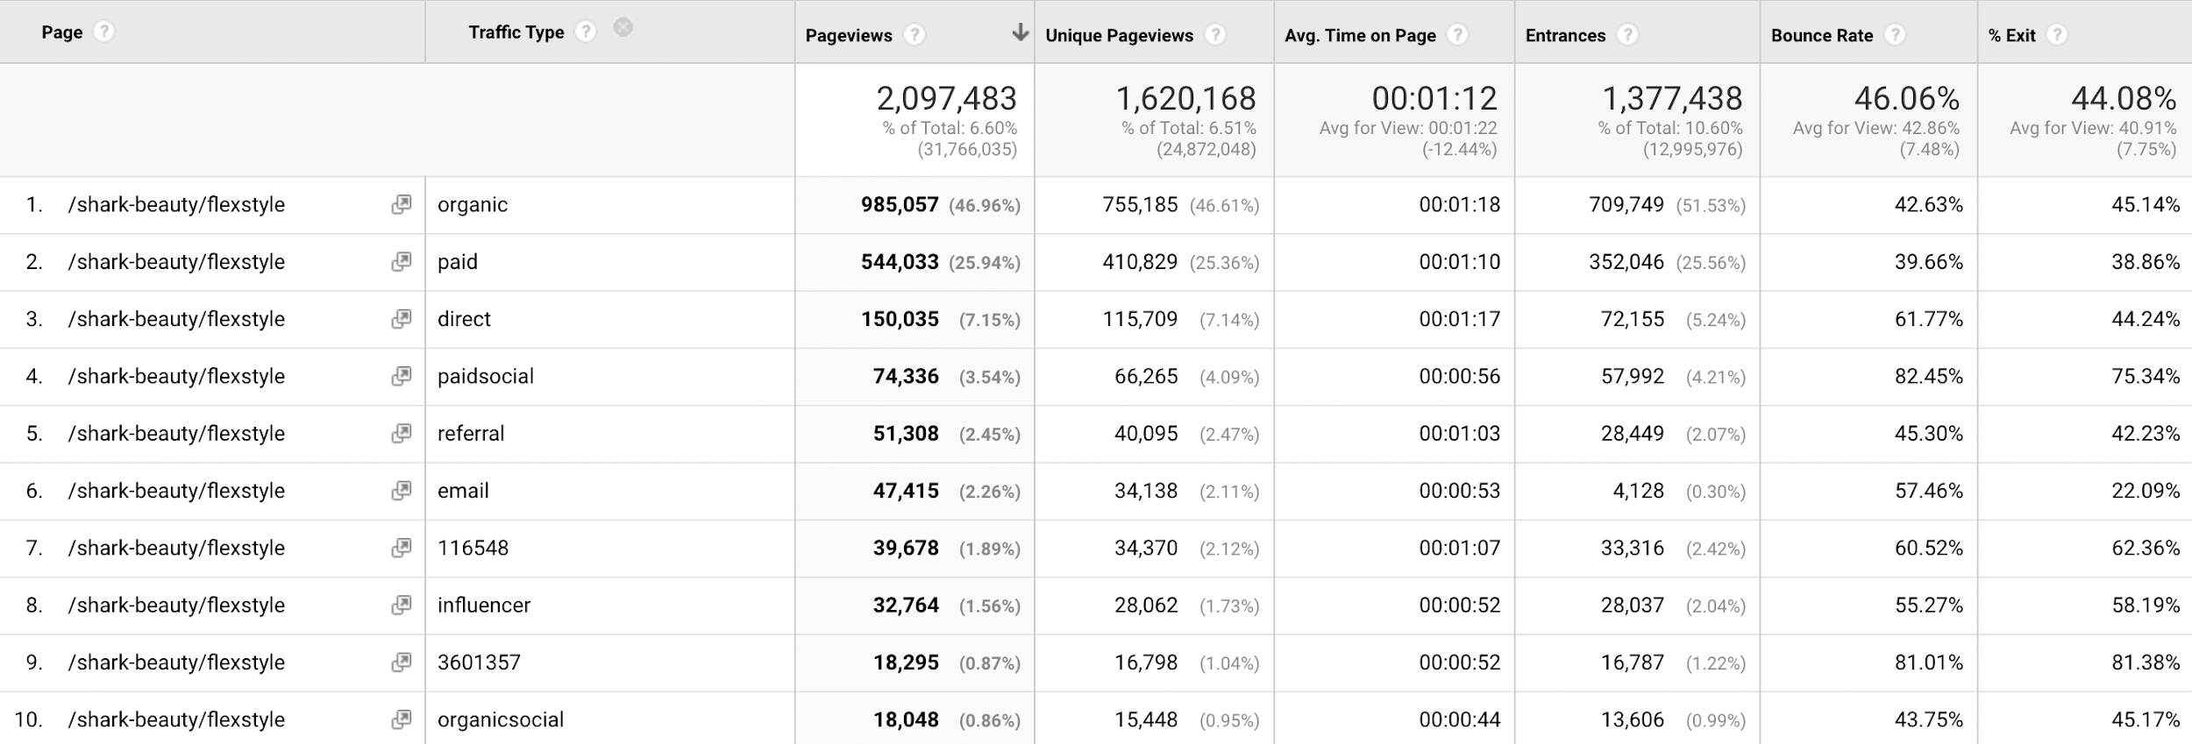
Mobile: 85.28%
Desktop: 13.85%
CHANNEL BEHAVIOR INSIGHTS
Date Range: August- December 2022 (only reflects top 10 traffic channels out of 225)
Notes:
Only reflects

Slide 2
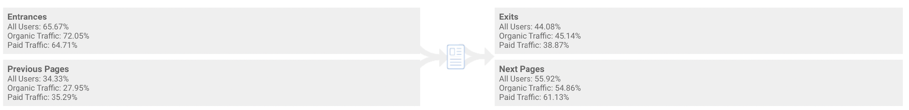
USER FLOWS
https://www.sharkclean.com/shark-beauty/flexstyle
Previous page paths leading to https://www.sharkclean.com/shark-beauty/flexstyle
https://www.sharkclean.com/
https://direct.sharkclean.com/hair-care-bundle/microsite/
https://www.sharkclean.com/exclusive-offer/hd430wk/shark-flexstyle-air-drying-styling-system-powerful-hair-blow-dryer-multi-styl/
https://www.sharkclean.com/exclusive-offer/hd440bkwk/shark-flexstyle-ultimate-6-piece-accessory-pack-powerful-hair-blow-/
https://www.sharkclean.com/shark-beauty/hyperair
Next page paths leading from
https://www.sharkclean.com/shark-beauty/flexstyle
https://direct.sharkclean.com/hair-care-bundle/microsite/
https://www.sharkclean.com/exclusive-offer/hd430wk/shark-flexstyle-air-drying-styling-system-powerful-hair-blow-dryer-multi-styl/
https://www.sharkclean.com/exclusive-offer/hd440bkwk/shark-flexstyle-ultimate-6-piece-accessory-pack-powerful-hair-blow-/
https://www.sharkclean.com/
https://www.sharkclean.com/store/
Notes:
https://analytics.google.com/analytics/web/#/report/content-pages/a76904607w225259305p213358839/_u.date00=20220824&_u.date01=20221206&_.useg=builtin1,builtin5,builtin4&explorer-table.plotKeys=%5B%5D&_r.drilldown=analytics.pagePath:~2Fshark-beauty~2Fflexstyle&_r.tabId=navigationsummary/

Slide 3
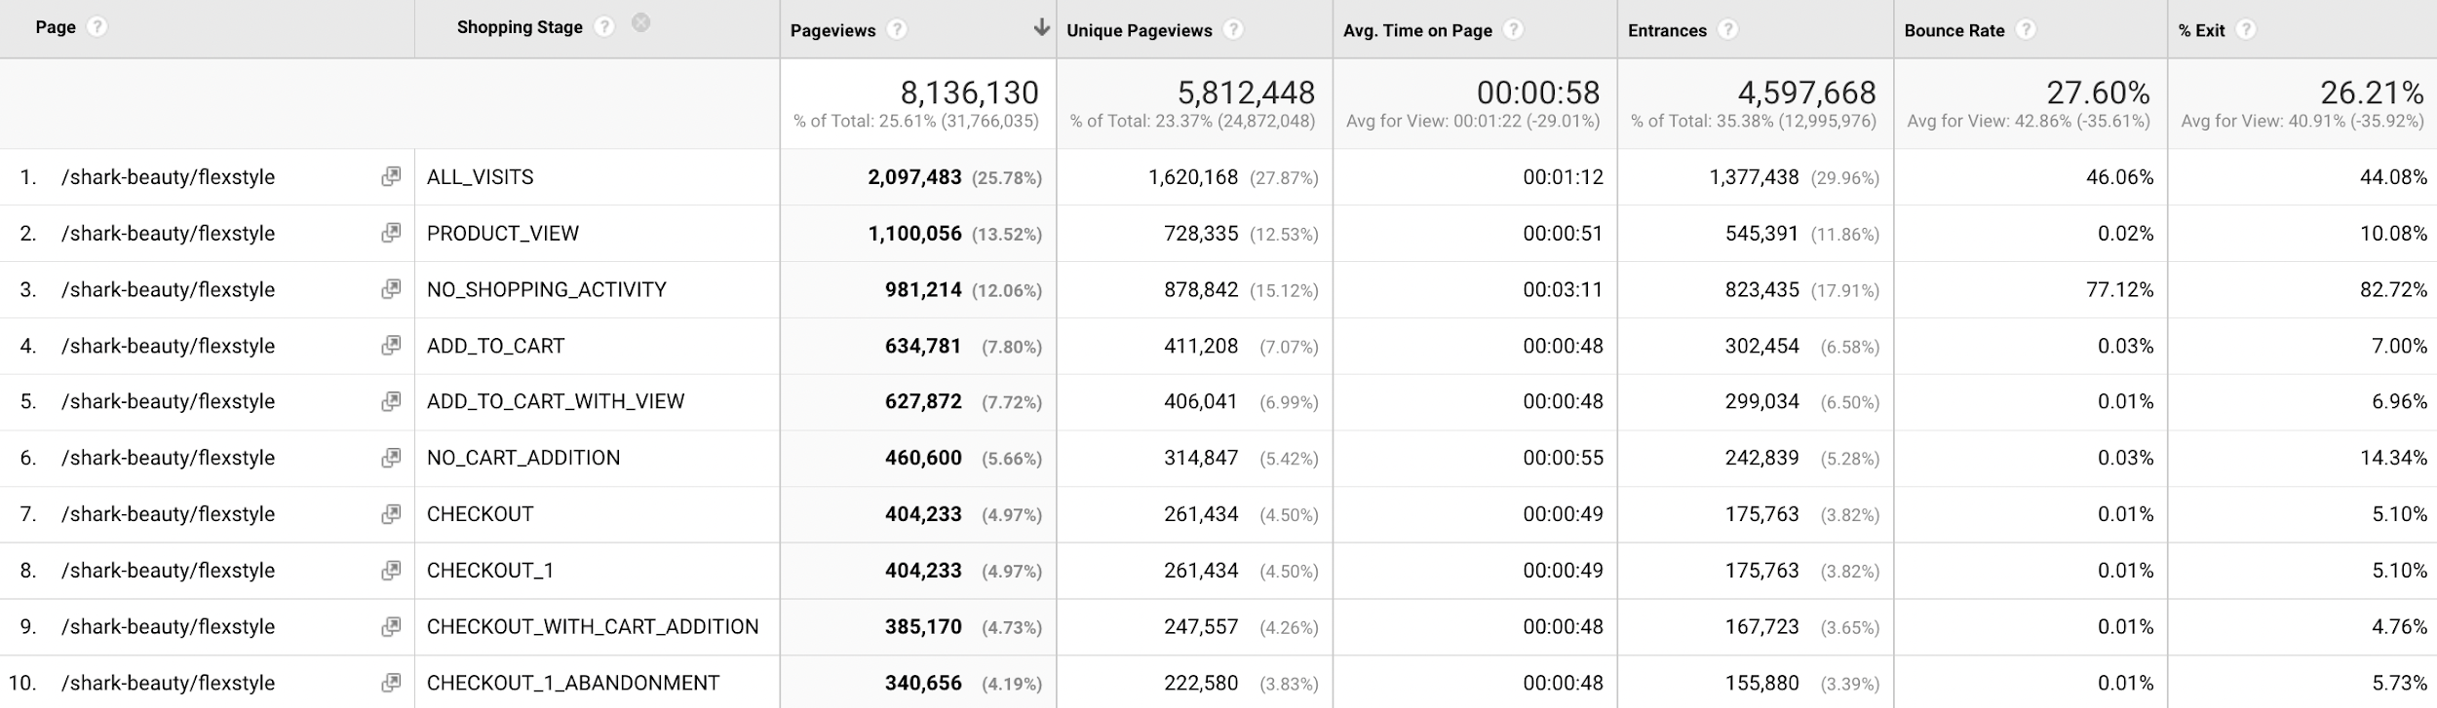
SHOPPING STAGE BEHAVIOR
Notes:
SALES CONVERSION

